Slide 1
Structured Query Language

Slide 2
SQL is everywhere
just about every computer and every person on planet eventually touches something running SQL
incredibly successful and solid technology
runs universities (System Informatics iNtegrated University), banks, hospitals, governments, small businesses, large ones
all Android Phones and iPhones have easy access to SQL database called SQLite
  many applications on your phone use it directly

Slide 3
learning SQL ?
weird obtuse kind of "non-language"
  that most programmers can't stand
based on solid mathematically built theory of operation (relational theory (extension of set theory))
actually, learn important theoretical concepts that apply to nearly every data storage system past and present

Slide 4
standard for Relational DataBase Management Systems: SQLite, PostGreSQL (most advanced Open Source DB), MySQL/MariaDB, SQL Server, Oracle, …
NoSQL

Slide 5
Non Procedural, Declarative Programming Language
(procedural) programming languages - variables and data structures, using conditional logic (i.e., if-then-else) and looping constructs (i.e., do while ... end), ….
procedural language defines both desired results and mechanism, or process, by which results are generated
nonprocedural languages define desired results, but process by which results are generated is left to an external agent
manner in which statement is executed is left to component of your database engine known as query optimizer
integrate SQL with programming language

Slide 6
SQL
pronounce SQL "sequel“
but you can also say "ESS-QUEUE-ELL" if you want
stands for Structured Query Language
language for interacting with data in (relational) database
matches theory established many years ago defining properties of well structured data

Slide 7
SQL operations
Create
  putting data into tables - INSERT
Read
  query data out of tables - SELECT
Update
  change data already in table - UPDATE
Delete
  remove data from table – DELETE
acronym "CRUD" is considered fundamental set of features every data storage system must have

Slide 8
imagine here some (nude) pictures of famous Daniela CRUDu …

Slide 9

Purpose of Database Systems:
CRUDu, Daniela

Slide 10
SQL - language for doing CRUD operations
SQL Data Definition Language - DDL
to produce new tables or alter existing ones
SQL only knows tables, and every operation produces tables
  by modifying an existing one
  or it returns new temporary table as your data set
SQL Data Manipulation Language – DML
SQL Security

Slide 11
SELECT

Slide 12
sqlzoo.net
3 laboratory works
A Gentle Introduction to
Structured Query Language

Slide 13
Why is it called SQLzoo?
The animals of this zoo are SQL engines - one of each species
They have been caged and tamed
The public can poke, prod and gawp - the exhibits and the public are protected from each other

Slide 14
Who runs this site?
Andrew Cumming is a lecturer at Napier University in Edinburgh, Scotland, UK
is the zoo keeper, he feeds the animals and shovels away the waste

Slide 15
Can I shake his hand? buy him a drink?
Next time you are visiting Edinburgh, UK you can shake his hand at the Tollcross State Circus which meets on Monday, 7pm to 9pm in Tollcross primary school

Slide 16
Can I buy him a drink?
You can buy him a drink afterwards, in the Blue Blazer, Spittal Street; a pint of 80 Shilling please
I (not Techical University of Cluj Napoca) will reimburse the expenses
  bring a proof

Slide 17
Notes for teachers
This material was designed to be used in supervised tutorials at Napier University
Teachers from other institutions are welcome to use it in any way they see fit, however I have a few requests / suggestions:
Reliability of the SQL Engines
  Sometimes long running processes accumulate
Feedback
  If you are making use of this material please let me know what worked well and what didn‘t
  Let me know if any of the questions are poorly phrased or confusing. I have tried to keep the language as simple as possible. Many students do not have English as their first language - I would like to hear more from them

Slide 18
Acknowledgements
The CIA
  Not just spying and wet work, they help you with your geography homework
BBC News - Country Profiles
Internet Movie Database
  wonderful way to waste hours
Scotland's Parliament
  They've got my vote.
TRAVELINE, Edinburgh City Council
Amazon, New Scientist

Slide 19
Basic Concepts and Principles
SQL Basic Concepts and Principles

Slide 20
in 1970, Dr. E. F. Codd of IBM’s research laboratory published paper titled “A Relational Model of Data for Large Shared Data Banks” that proposed that data be represented as relations, sets of tables
redundant data used to link records in different tables

Slide 21
each table in relational database includes information that uniquely identifies row in that table (known as primary key), along with additional information needed to describe entity completely
some tables also include information used to navigate to another table; this is where “redundant data” mentioned earlier comes in
these columns are known as foreign keys, and they serve purpose as lines that connect entities

Slide 22
Terminology
Entity - something of interest to database user community; examples include customers, parts, geographic locations, etc.
Column - individual piece of data stored in table
Row - set of columns that together completely describe entity; also called record
Table - set of rows, held on permanent storage (persistent)
Result set - another name for nonpersistent table, generally result of SQL query
Primary Key - one or more columns that can be used as unique identifier for each row in table
Foreign Key - one or more columns that can be used together to identify single row in another table

Slide 23
Terminology
Result set - another name for nonpersistent table, generally result of SQL query
SQL goes with relational model - result of SQL query is table (also called, in this context, result set)
table can be created in relational database simply by storing result set of query
query can use both permanent tables and result sets from other queries as inputs

Slide 24
Star Wars

Slide 25


Release order
Chronological order
Star Wars: A New Hope (Episode IV) (1977)
Star Wars: The Empire Strikes Back (Episode V) (1980)
Star Wars: Return of the Jedi (Episode VI) (1983)
Star Wars: The Phantom Menace (Episode I) (1999)
Star Wars: Attack of the Clones (Episode II) (2002)
Star Wars: Revenge of the Sith (Episode III) (2005)
Star Wars: The Force Awakens (Episode VII) (2015)
Star Wars: The Last Jedi (Episode VIII) (2017)
Star Wars: The Rise of Skywalker (Episode IX) (2019)
Star Wars: The Phantom Menace (Episode I) (1999)
Star Wars: Attack of the Clones (Episode II) (2002)
Star Wars: Revenge of the Sith (Episode III) (2005)
Star Wars: A New Hope (Episode IV) (1977)
Star Wars: The Empire Strikes Back (Episode V) (1980)
Star Wars: Return of the Jedi (Episode VI) (1983)
Star Wars: The Force Awakens (Episode VII) (2015)
Star Wars: The Last Jedi (Episode VIII) (2017)
Star Wars: The Rise of Skywalker (Episode IX) (2019)

Slide 26
DataBases

Slide 27
DataBase Laboratory
14 weeks semester university course about DataBase
organized in many parts of the three:
  three parts Structured Query Language SQL,
  three parts relational databases (SQLite and PostGreSQL),
  three parts more relational database,
  three parts developing applications with database
  non-relational databases
  …

Slide 28
for practicing with databases, we don’t need three but only two things:
  back-end: access to a database server, database engine
  front-end: a tool to work with databases

Slide 29
BackEND
SQLite

Slide 30
SQLite Home Page https://www.sqlite.org/
SQLite is a C-language library that implements a small, fast, self-contained, high-reliability, full-featured, relational database engine
most used database engine in the world
  built into mobile phones applications, bundled inside countless other applications
  there are over 1 trillion SQLite databases in active use

Slide 31


Slide 32
SQLite
SQLite source code is in the public-domain
free to everyone to use for any purpose
file format is stable, cross-platform, and backwards compatible
  developers pledge to keep it that way through the year 2050

Slide 33
SQLite
a complete database is stored in a single cross-platform disk file, it is a document database
zero-configuration - no setup or administration needed
full-featured SQL complaint relational database implementation with advanced capabilities like indexes, support for JSON, …
supports terabyte-sized databases and gigabyte-sized strings and blobs
small code footprint: less than 750KB fully configured or much less with optional features omitted

Slide 34
SQLite
written in ANSI-C - simple, easy to use API; bindings for dozens of other languages are available
self-contained: no external dependencies
cross-platform: Android, iOS, Linux, Mac, Solaris, and Windows are supported out of the box
fast: in some cases, SQLite is faster than direct filesystem I/O
transactions in SQLite are Atomic, Consistent, Isolated, and Durable (ACID) even after system crashes and power failures

Slide 35
SQLite
Installation
love Apple Mac OS and Linux but we take into consideration that majority of students have Microsoft Windows operating system workstations

Slide 36
SQLite
Installation
SQLite does not have a separate server process like most other SQL databases – it is not a proper server
to install SQLite open download page https://www.sqlite.org/download.html
then, download and extract the ZIP files with 64-bit DLL for SQLite - build products are named using following templates: sqlite-product-version.zip.

Slide 37
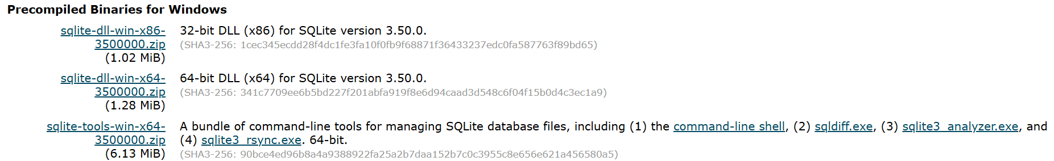
SQLite
Installation

Slide 38
SQLite
Installation
SQLite-dll-win-x64-3.50.0 ZIP file extraction, save following files
move SQLite files into an appropriate folder on your operating system and then add that folder to your operating system’s PATH variable in order to make the database globally accessible.
in C:\WINDOWS\system32 folder (or any other that is in your PATH); this folder contains important operating system files that Windows needs in order to function properly

Slide 39
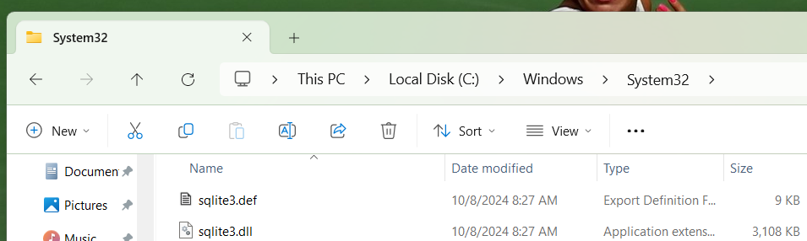
SQLite
Installation
move sqlite3.def and sqlite3.dll in in C:\WINDOWS\system32 folder

Slide 40
many microdevices and Mac OS and Linux distributions come with SQLite preinstalled
always smart to check if it’s already installed
to verify SQLite on your local OS, simply issue the sqlite3 --version command in a terminal window

Slide 41
FRONTEND

Slide 42
Command Line
usually there are command line tools to interact with the database: sqlite3, psql, or other …
these tools can be used to enter SQL queries directly or execute them from a file
in addition, such tools provide several meta-commands and various shell-like features to facilitate writing and running scripts and automating a wide variety of tasks

Slide 43
Canonical
canonical database front end tools like pgAdmin - PostgreSQL Tools https://www.pgadmin.org/
free and open-source Graphical User Interface administration tool only for PostgreSQL, provided by the makers of PostGreSQL, which is supported on many computer platforms

Slide 44
Universal
works with many different DataBase Management Systems
for example, a very good one such tool is DataGrip: Cross-Platform IDE for Databases & SQL by JetBrains
https://www.jetbrains.com/datagrip/
powerful cross-platform tool for relational and NoSQL databases
freely available in Student Pack for full-time students at accredited academic institutions in a program lasting at least one year based on university email address – could be renew

Slide 45

recommend the use of DBeaver Community | Free Universal Database Tool https://dbeaver.io/
free cross-platform universal database tool for developers, database administrators, analysts, database managers and everyone working with data and databases
DBeaver supports all popular SQL databases like PostgreSQL, SQLite, MySQL, MariaDB, SQL Server, Apache Family, and more.

Slide 46
Example
Example

Slide 47
Best DataBase textbook?
Past: An Introduction to Database Systems 1st Edition, by C. J. Date (Date, 1975) the father of DataBase, 8th Edition (Date C. , 2003)
Present: Database Management Systems, by Raghu Ramakrishnan and Johannes Gehrke (Gehrke, 2007).
Future: ?

Slide 48

The future of data(base) education: Is the "cow book" dead?

Slide 49
Structured Query Language was presented using a simple star schema with Customers, Suppliers and Parts
in present times a database with Sailors, Boats and Reserves was used

Slide 50
we draw our inspiration from
https://www.youtube.com/watch?v=FOt3oQ_k008
and All for Love https://www.youtube.com/watch?v=ofA3URC1wyk
start database and DBeaver

Slide 51
from the online on the book's webpage at http://www.cs.wisc.edu/-dbbook
includes instructions on how to set up Oracle, IBM DB2, Microsoft SQL Server, and MySQL, and scripts for creating the example tables and queries.

Slide 52
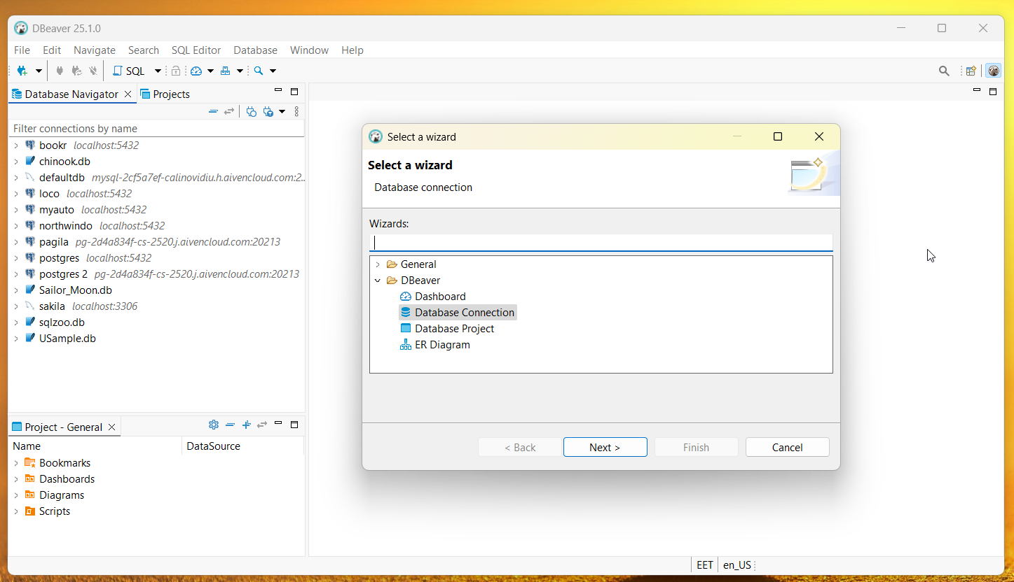

Slide 53
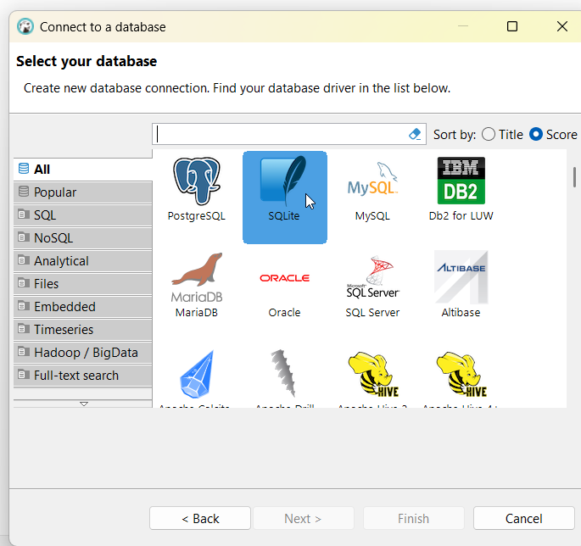
DBeaver
File – New – DataBase Connection
and Connect to SQLite DataBase

Slide 54
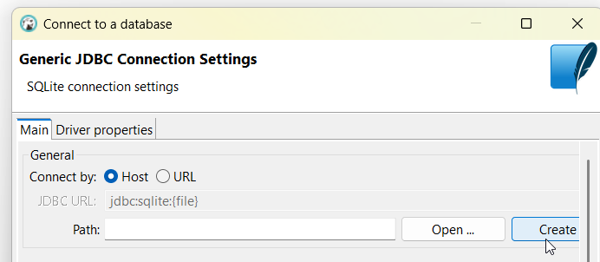
Create a New DataBase; .db or .sqlite could be common extension names for a SQLite database. …

Slide 55
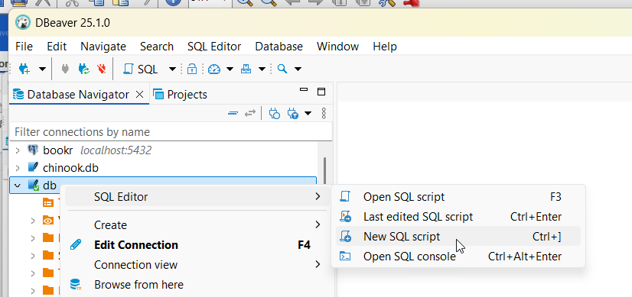
and let’s open a new SQL script in newly created database

Slide 56
CREATE TABLE sailors (
sid integer NOT NULL PRIMARY KEY,
sname varchar(50) NOT NULL,
rating integer NOT NULL,
age double NOT NULL );
INSERT INTO sailors ( sid, sname, rating, age)
VALUES
( 22, 'Dustin', 7, 45.0),
( 29, 'Brutus', 1, 33.0),
( 31, 'Lubber', 8, 55.5),
( 32, 'Andy', 8, 25.5),
( 58, 'Rusty', 10, 35.0),
( 64, 'Horatio', 7, 35.0),
( 71, 'Zorba', 10, 16.0),
( 74, 'Horatio', 9, 35.0),
( 85, 'Art', 3, 25.5),
( 95, 'Bob', 3, 63.5);
CREATE TABLE boats (
bid integer NOT NULL PRIMARY KEY,
bname varchar(50) NOT NULL,
color varchar(50) NOT NULL );
INSERT INTO boats ( bid, bname, color)
VALUES
(101, 'Interlake', 'blue'),
(102, 'Interlake', 'red'),
(103, 'Clipper', 'green'),
(104, 'Marine', 'red');
CREATE TABLE reserves (
sid integer NOT NULL ,
bid integer NOT NULL ,
day integer NOT NULL ,
FOREIGN KEY(sid) REFERENCES sailors(sid),
FOREIGN KEY(bid) REFERENCES boats(bid),
PRIMARY KEY (sid, bid, day)
);

Slide 57
INSERT INTO reserves ( sid, bid, day)
VALUES
( 22, 101, 1),
( 22, 102, 1),
( 22, 103, 2),
( 22, 104, 3),
( 31, 102, 4),
( 31, 103, 5),
( 31, 104, 6),
( 64, 101, 7),
( 64, 102, 8),
( 74, 103, 8);

Slide 58
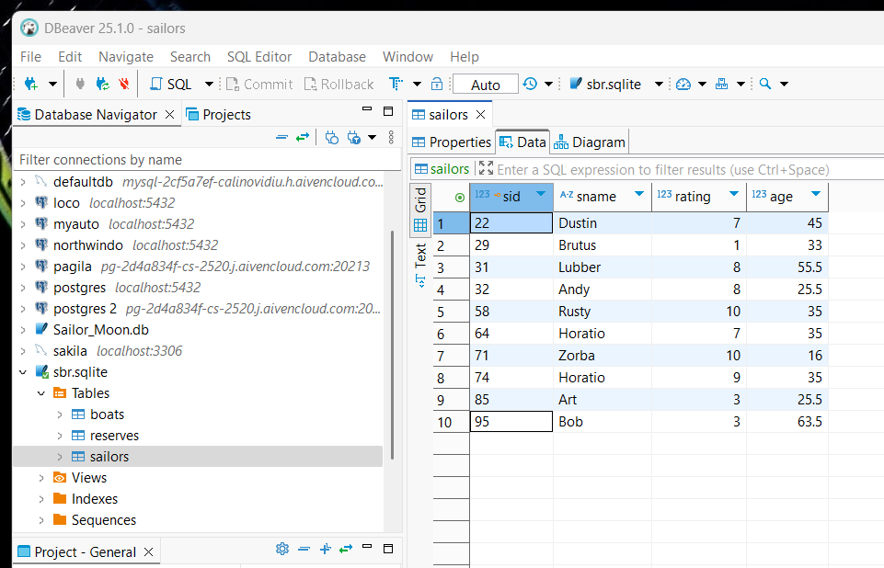
To check that everything was all right can use the View Table option

Slide 59
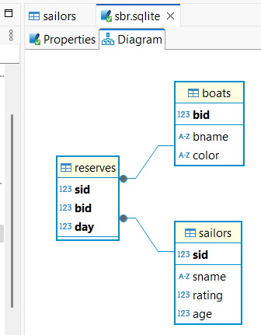
DataBase Diagram

Slide 60
Structured Query Language (SQL) is the most widely used commercial relational database language
originally developed at IBM in the SEQUEL and System-R projects (1974-1977)
other vendors introduced relational DBMS products based on SQL, and it is now a de facto standard
current ANSI/ISO standard for SQL is called SQL:1999
while not all DBMS products support the full SQL:1999 standard yet, vendors are working toward this goal and most products already support the core features.

